Slide 1
Mastering Embedded System Diploma learn-in-depth.com First Term (Final Project 1) Omar Mohamed Ayman My Profile: https://www.learn-in-depth.com/online-diploma/ommoor642@gmail.com

Slide 2
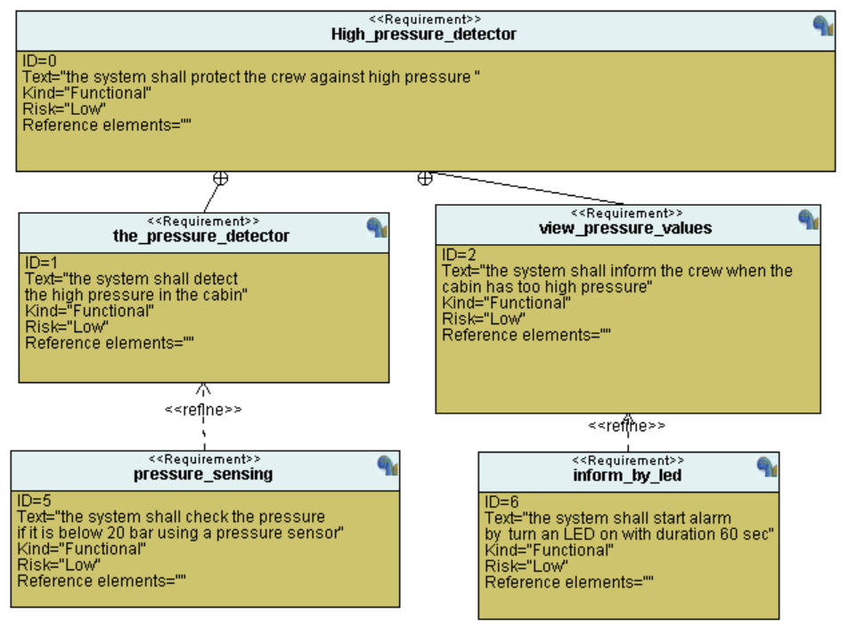
Requirement Diagram

Slide 3
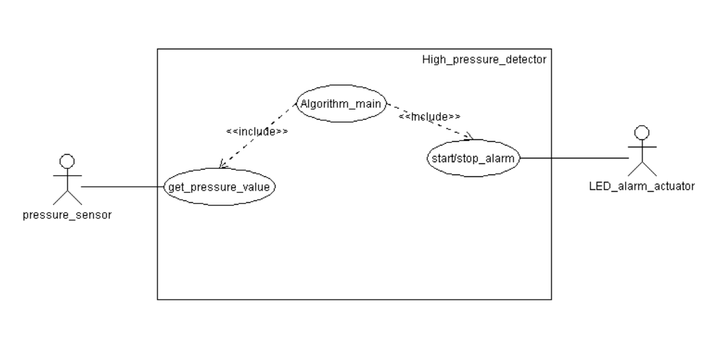
Use Case Diagram

Slide 4
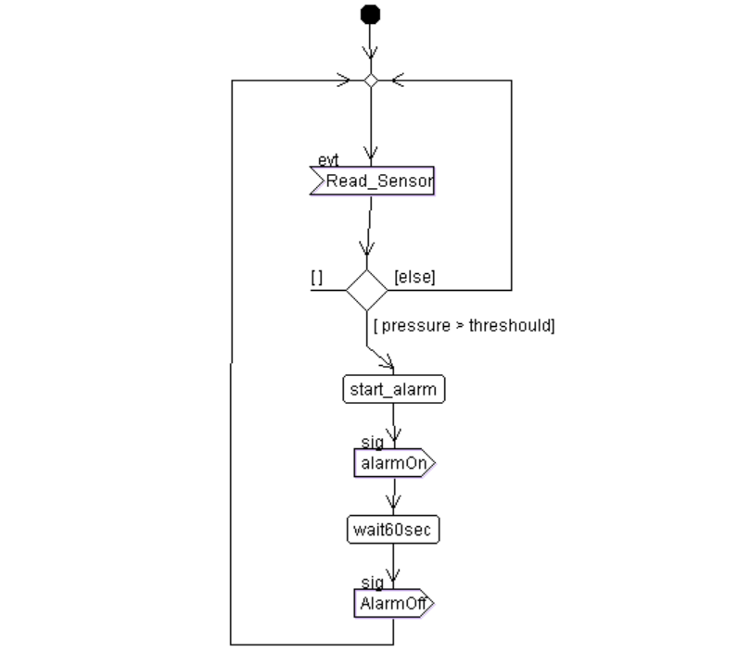
Activity Diagram

Slide 5
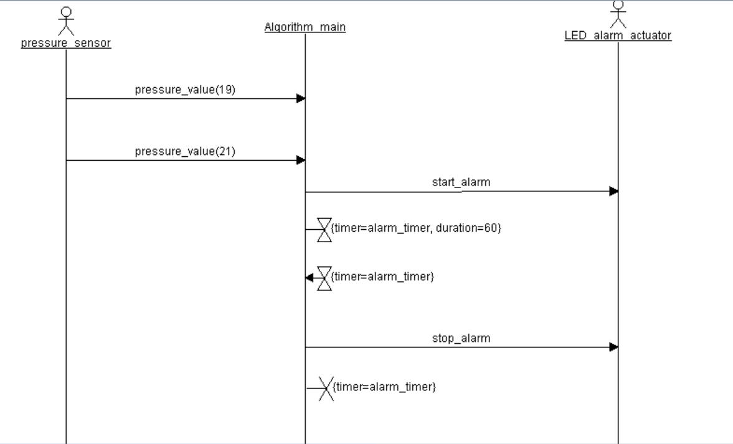
Sequence Diagram

Slide 6
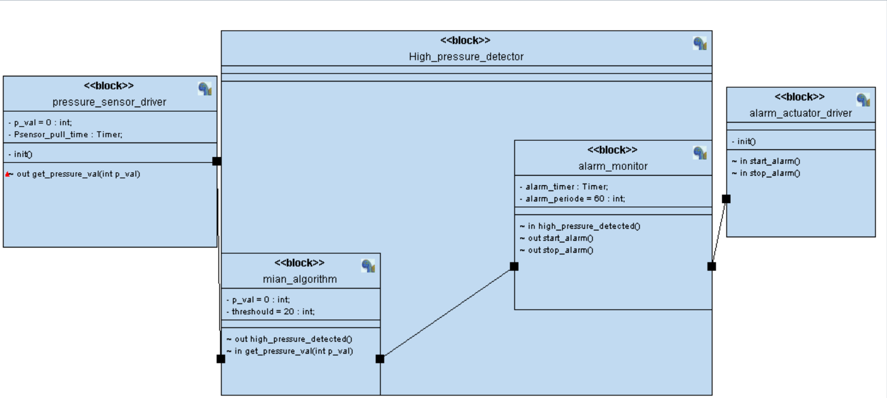
Design Modules

Slide 7
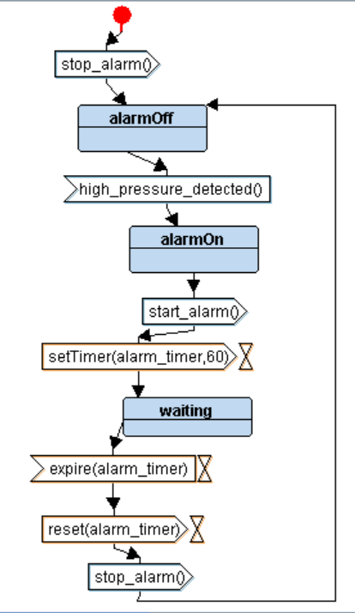
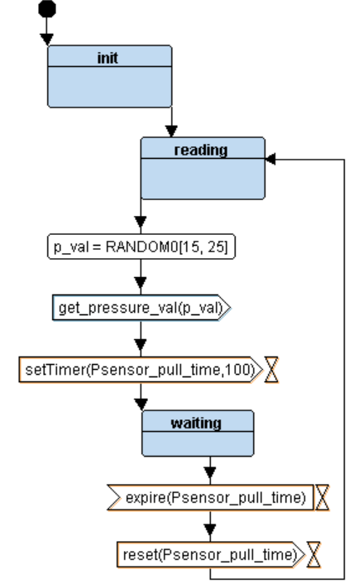
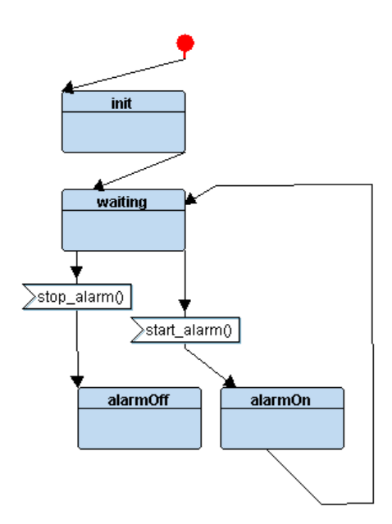
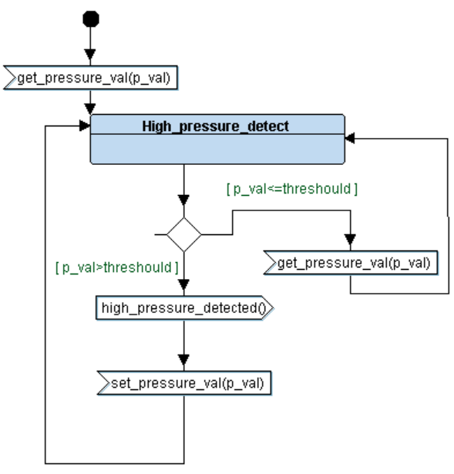
The state machines
monitor
The sensor
the alarm
main

Slide 8
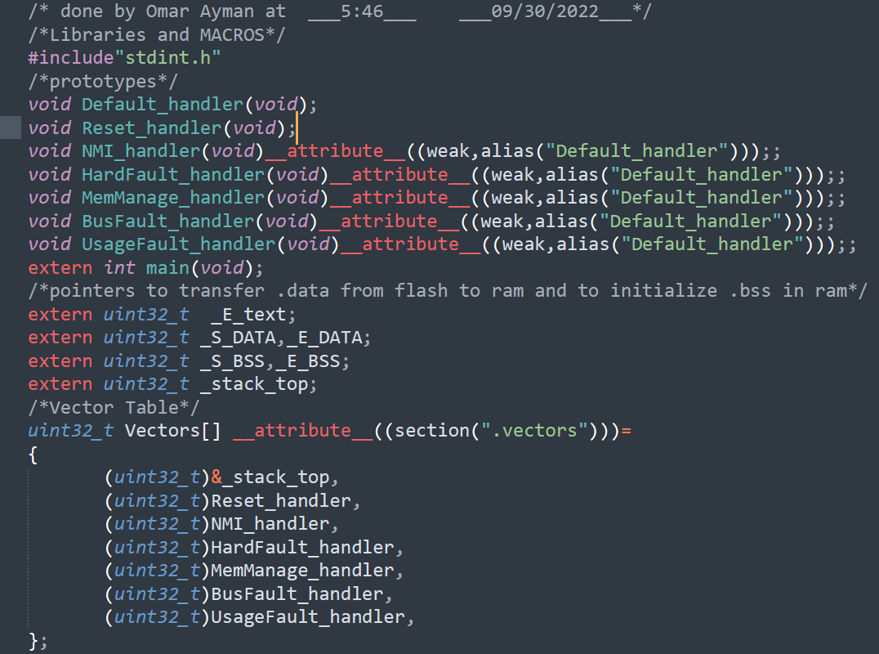
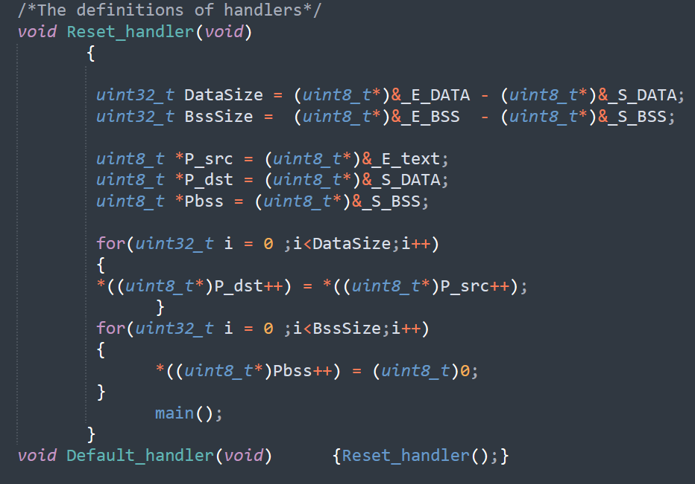
Programming :::: Startup.c

Slide 9
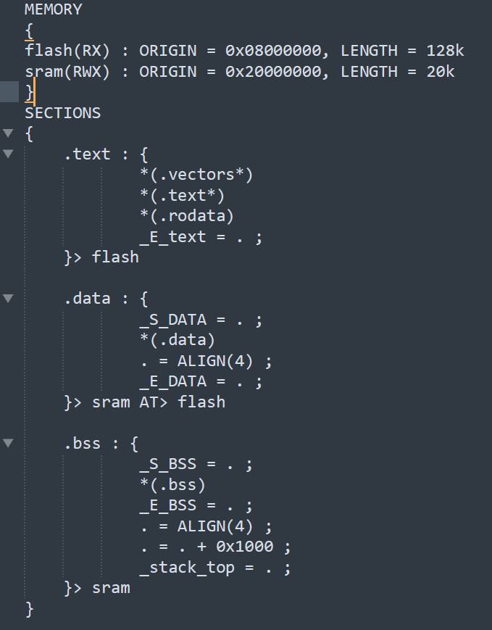
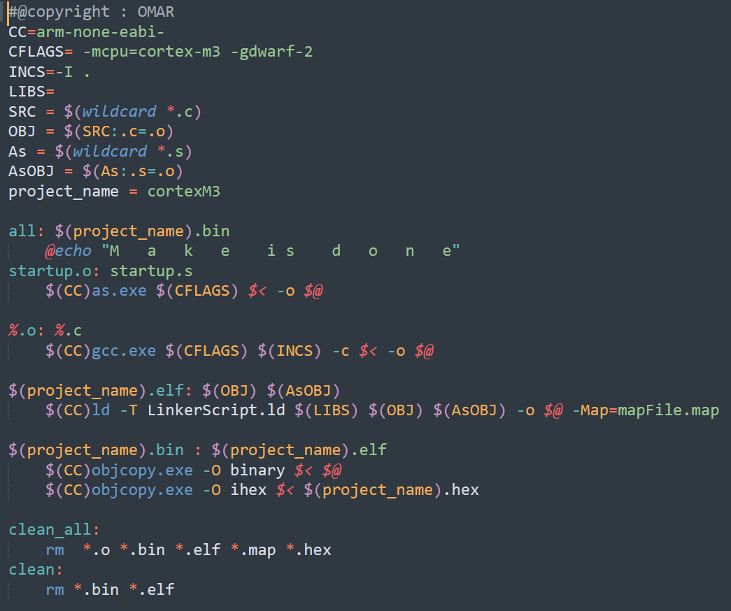
Programming :::: LinkerScript.ld & makeFile

Slide 10
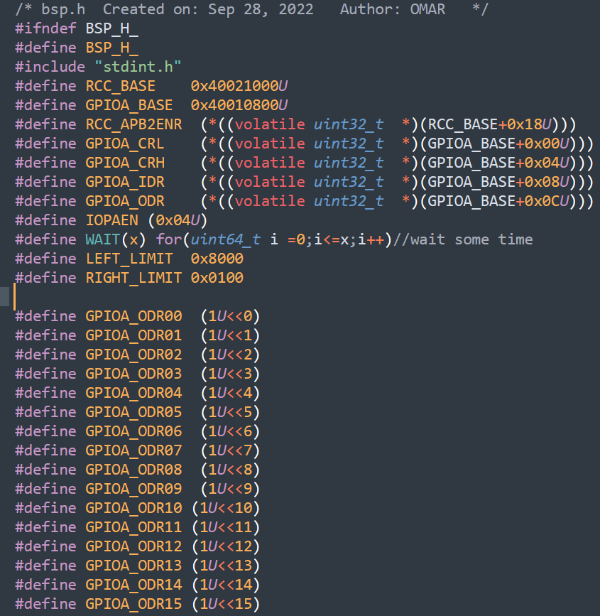
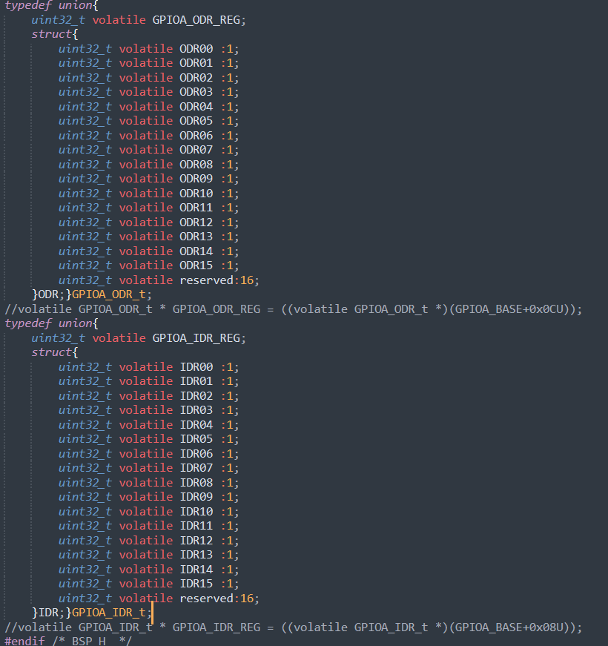
Programming :::: bsp.h

Slide 11
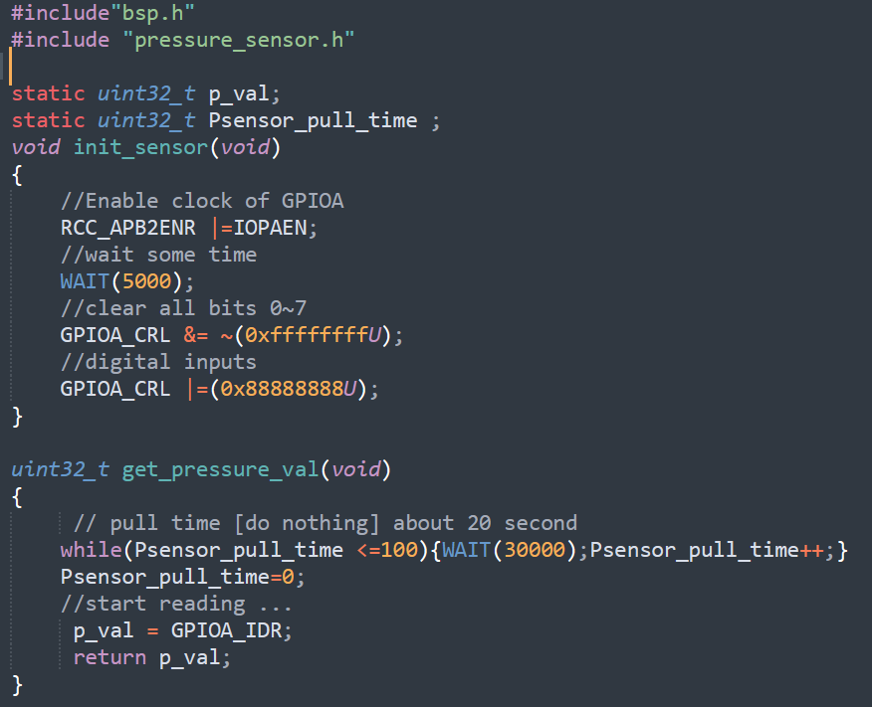
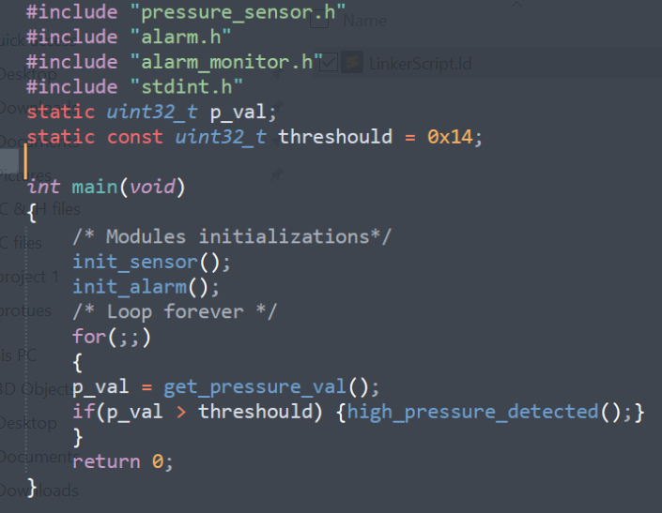
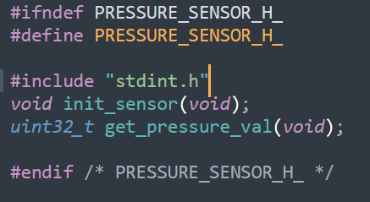
Programming :::: mainALG.c & pressure.c & pressure.h

Slide 12
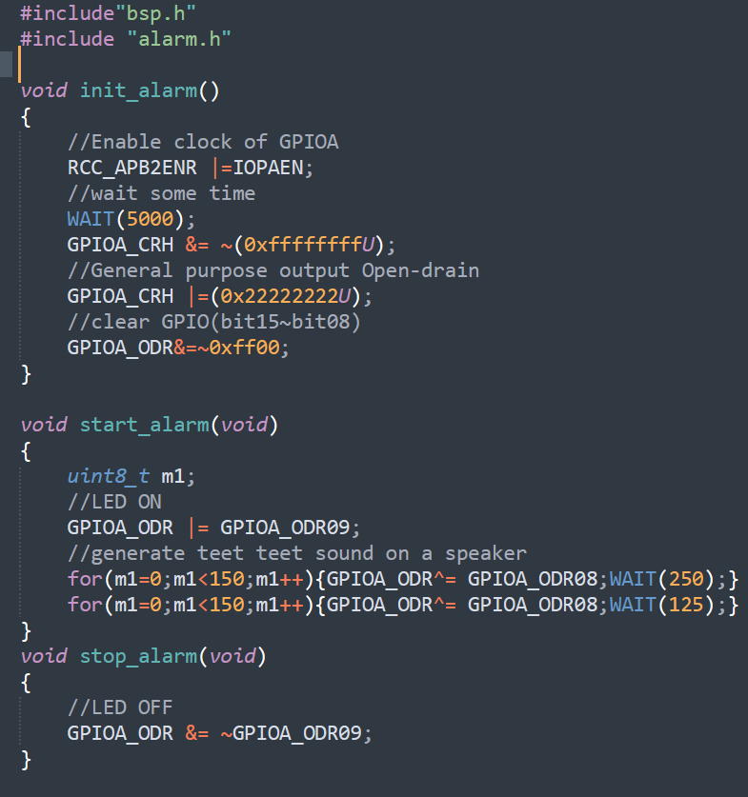
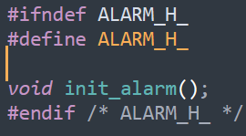
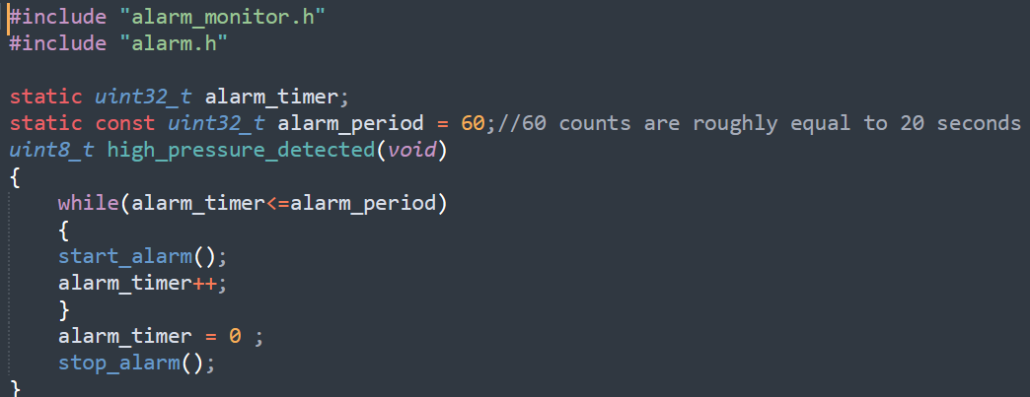
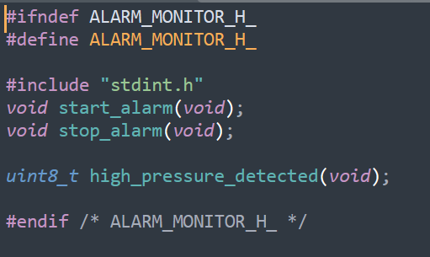
Programming :::: alarm.c & alarm.h & alarm_monitor.c & alarm_monitor.h

Slide 13
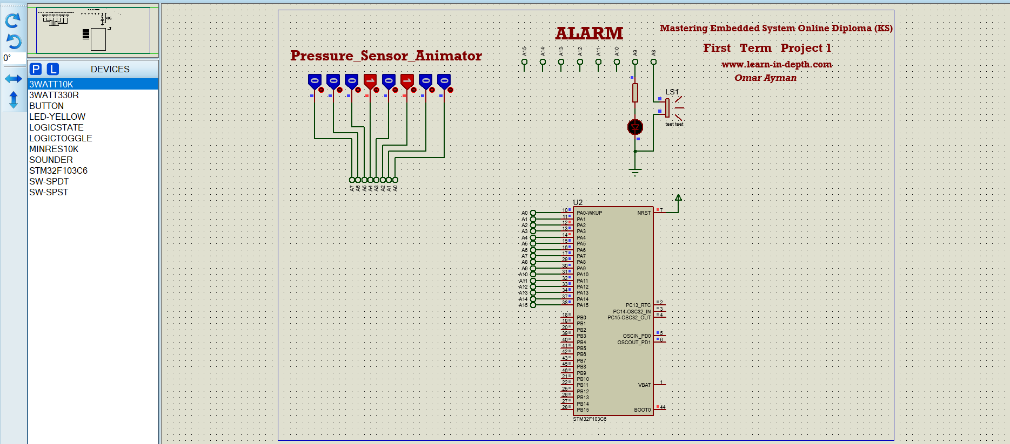

Test cases
Pressure = 20 :::: alarm is turned off
Pressure = 21 :::: alarm is turned on

Slide 14
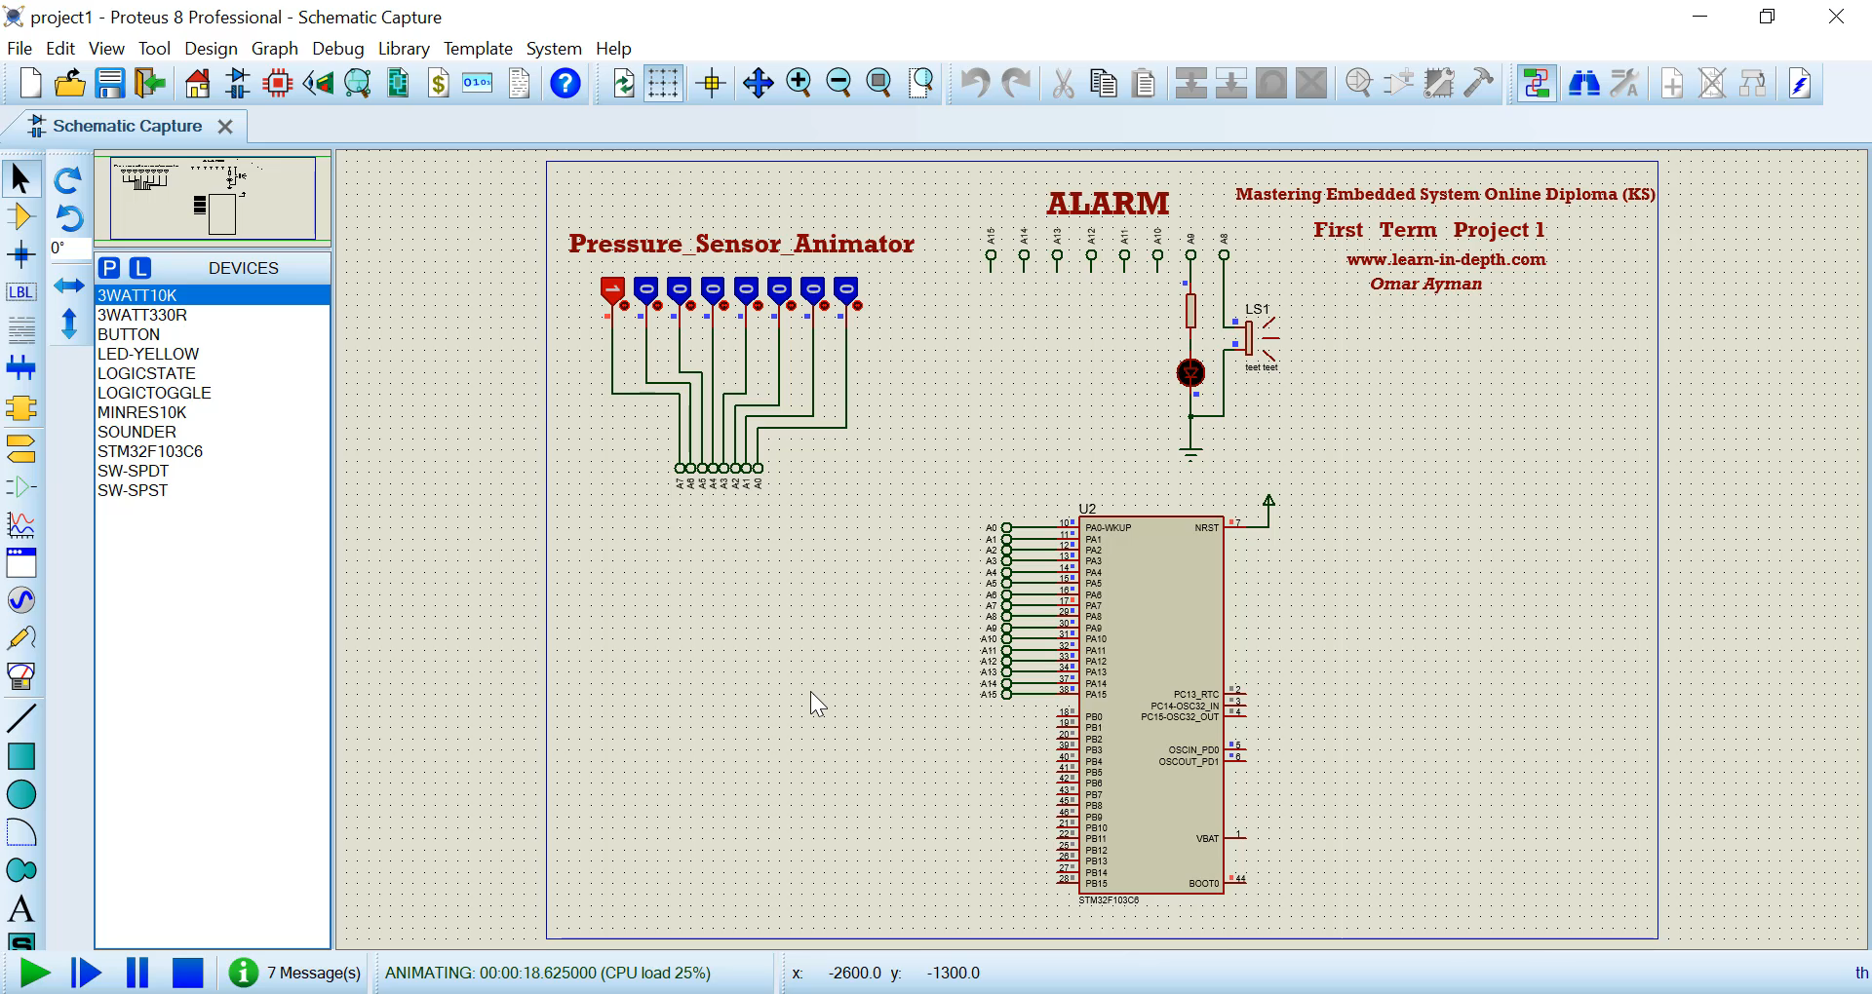
Programming :::: simulation in proteus

